Slide 1
Android Neural Networks API - (NNAPI)
Group 4

Slide 2
Machine Learning Glossary
Model - Algorithm or a mathematical representation of objects which processes large amounts of data to find patterns or make predictions.
Trained model - Model that has been given set of preprocessed data (training data) to optimise the parameters which are aimed to maximize accuracy, recall, prediction.
Inference - Applying/using a trained ML model to predict based on new features (input).
ML frameworks - TensorFLow and PyTorch - Libraries providing abstraction to help develop and train ML models.

Slide 3
What is NNAPI?
Android Native Development Kit (NDK) API written in C programming language.
Used for running computationally intensive ML operations on Android devices.
Base layer for ML frameworks like Tensorflow Lite and PyTorch.
Typically used to perform hardware-accelerated output operations on supported devices.
Train models outside the device and run inference on the device.
Works with Android 8.1+

Slide 4
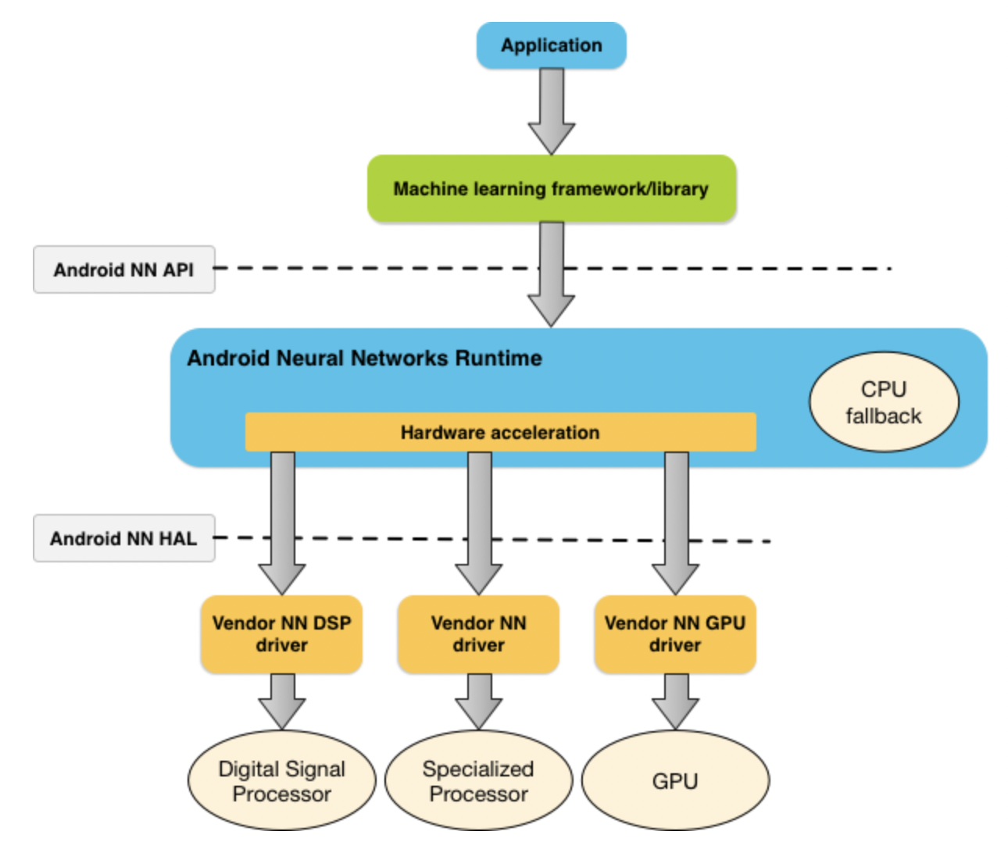
How NNAPI works
Android NN API - Abstraction used by applications or ML frameworks.
Android NN HAL - Hardware abstraction Layer that vendors implement to allow the API runtime to discover available hardware accelerators. Includes GPUs and DSPs.

Slide 5
Benefits and Drawbacks
Reduced latency - Inferencing by applying data on the android device directly instead of network call.
Privacy - Data stays within the device
Cost effective - Applications that are serverless will have to run fewer computations and can save that cost.
Application size - Increases application size based on the model being run.
Power usage - Since computations are being locally, more power is consumed by the device.

Slide 6
How to use NN API directly
Model - instance of ANeuralNetworksModel - A computation graph of mathematical operations and the constant values learned through a training process.
Compilation - instance of ANeuralNetworksCompilation - Compiling the model into lower level code. It can be reused across threads.
Execution - instance of ANeuralNetworksExecution - Used for applying inference for different set of inputs and gather outputs.
Memory - instance of ANeuralNetworksMemory - Represents shared memory buffer used across all three stages. Can also be created to store input and output of an execution instance.

Slide 7
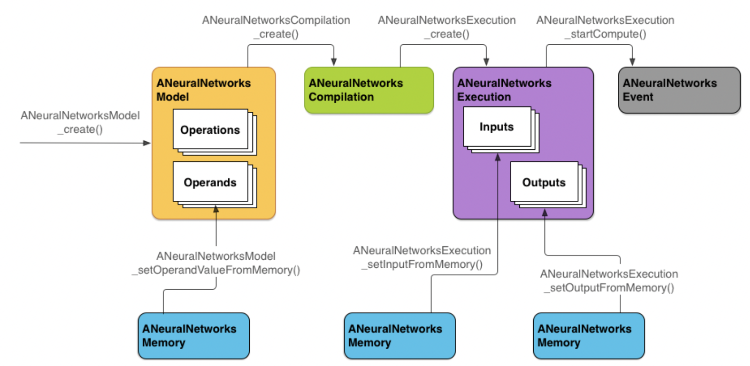

Slide 8
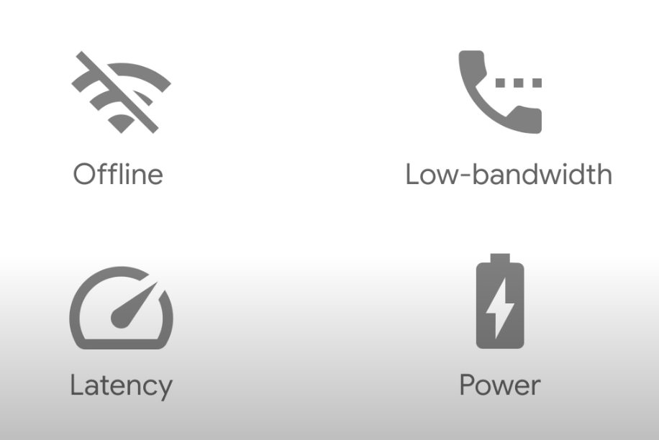
Why do we need to run ML models on device?
Notes:
Include privacy

Slide 9
Edge Computing
Edge computing is the practice of moving compute and storage resources closer to the location at which it is needed.
Challenges:
Limited compute power
Limited memory
Application size
Battery Consumption
Heterogeneity
Notes:
° Battery consumption
Heterogeneity

Slide 10
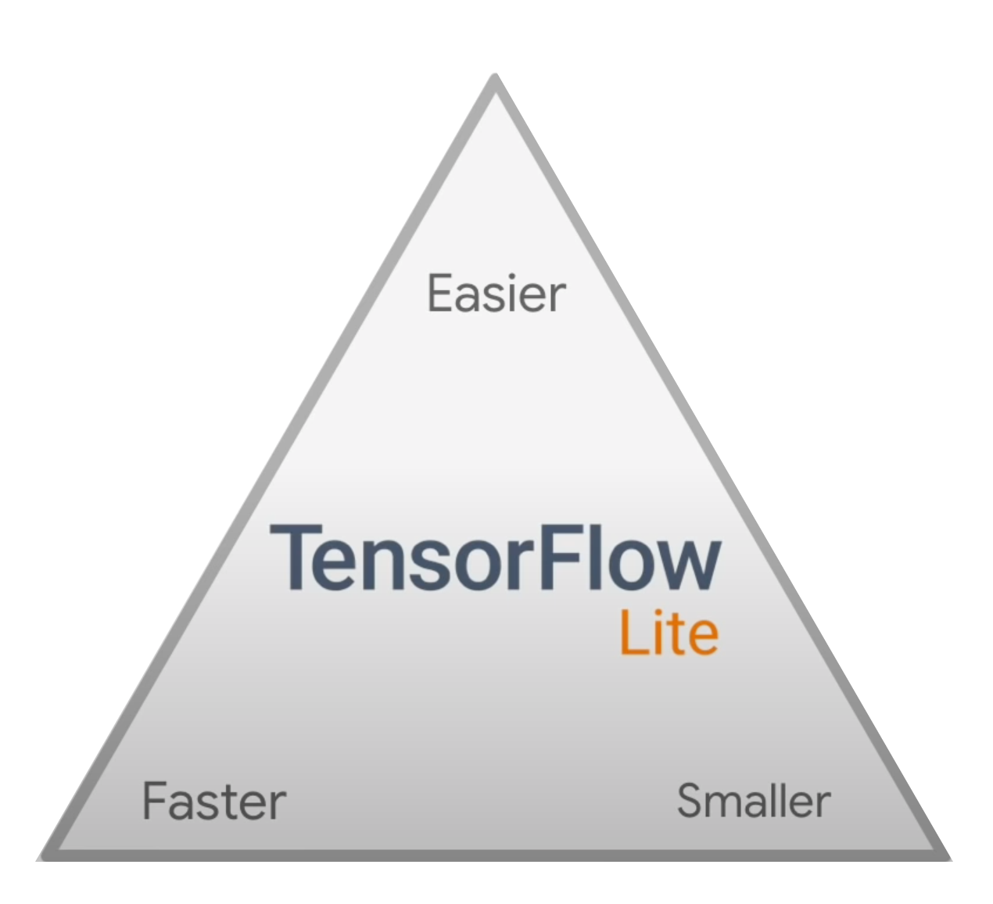
TensorFlow Lite
TensorFlow Lite provides a set of tools that enables on-device machine learning by allowing developers to run their trained models on mobile, embedded, and IoT devices and computers. It supports platforms such as embedded Linux, Android, iOS, and MCU.
Smaller
Model Size (Flatbuffers)
Easier
Inference-oriented APIs
Straightforward conversion
Faster
Low overhead

Slide 11
Development Workflow
Steps:
Generate a TensorFlow Lite model
Use an existing TensorFlow Lite model
Create a TensorFlow Lite model
Convert a TensorFlow model into a TensorFlow Lite model
Run inference
Loading a model
Transforming data
Running inference
Interpreting output

Slide 12
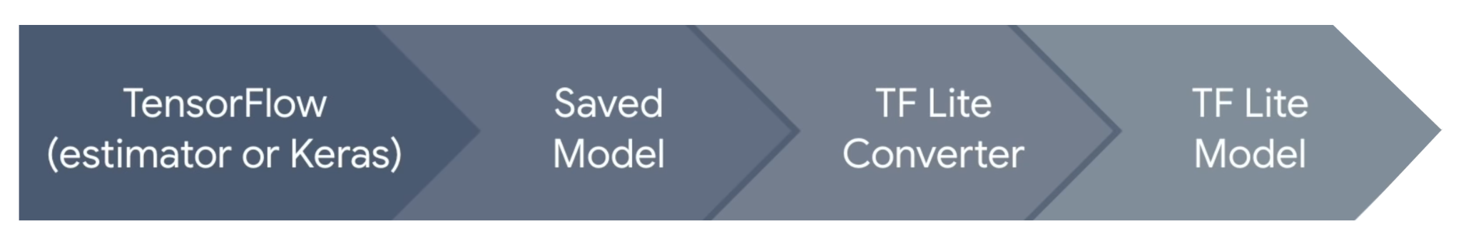
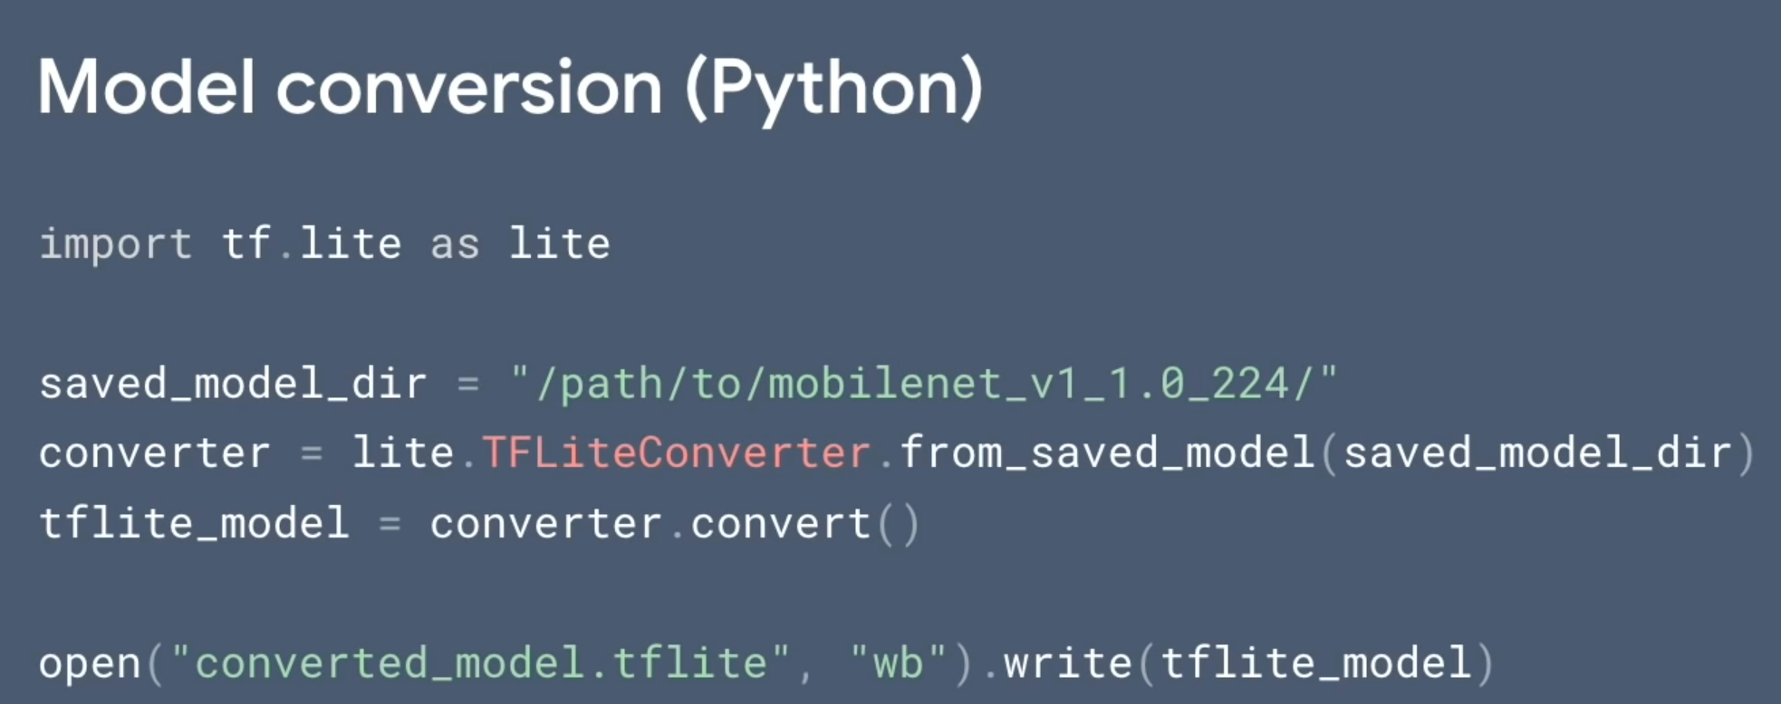

Slide 13
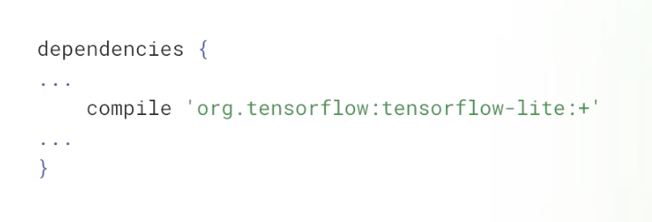
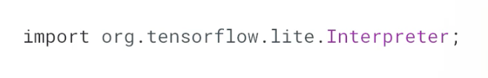
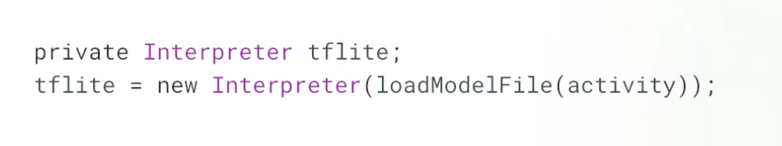

Slide 14
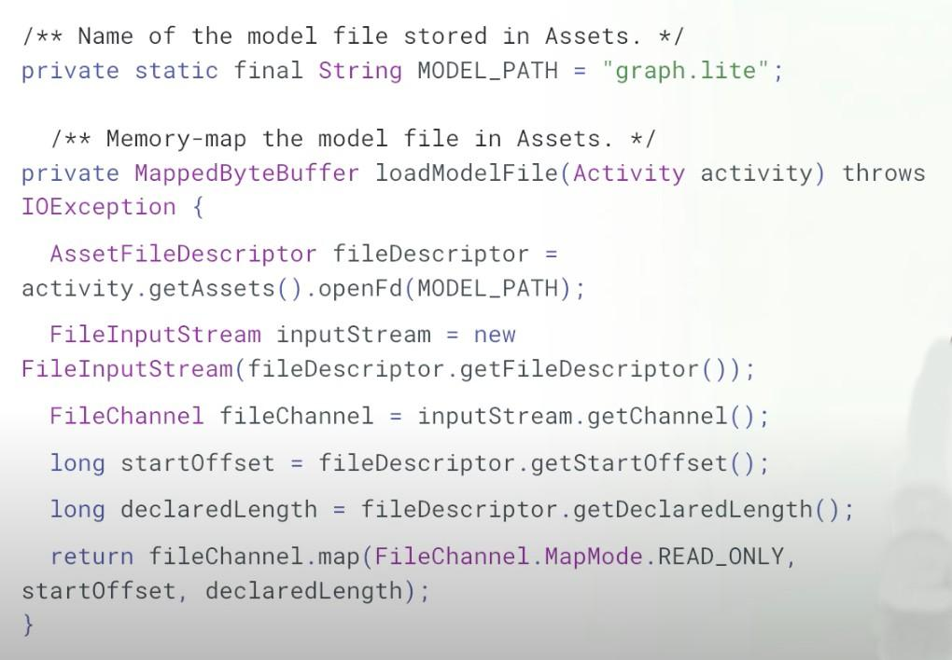

Slide 15
NNAPI in TensorFlow Lite
import org.tensorflow.lite.Interpreter;
import org.tensorflow.lite.nnapi.NnApiDelegate;
Interpreter.Options options = (new Interpreter.Options());
NnApiDelegate nnApiDelegate = null;
// Initialize interpreter with NNAPI delegate for Android Pie or above
if(Build.VERSION.SDK_INT >= Build.VERSION_CODES.P) {
nnApiDelegate = new NnApiDelegate();
options.addDelegate(nnApiDelegate);
}
// Initialize TFLite interpreter
try {
tfLite = new Interpreter(loadModelFile(assetManager, modelFilename), options);
} catch (Exception e) {
throw new RuntimeException(e);
}

Slide 16
Best Practices
Use mobile-optimized models (MobileNet vs. Inception)
Use the benchmark/profiling tools
Use quantization when possible
Leverage accelerators when available
Explore multi-threading

Slide 17
Thank you!

